Slide 1
NYC Vehicle Collision Analysis
Anish Basnet
Bhimsen Bhattarai
Celina Maharjan
Rajeev Kuikel

Slide 2
Objective
Provide user specific data:
the action of the driver right before the occurrence of the accident,
the direction the vehicles were heading towards during the accident,
the number of specific make and model of the vehicles involved in accidents, and
the number of specific vehicle body type involved in the accident during the timeline in New York according to the data set provided.

Slide 3
Datasets
-Extracted from Motor Vehicle Crashes in New York
-Contains all the accident details till 2016
-Two tables containing vehicle and their accident information
LINK
Click Here to Go to Dataset Link

Slide 4
Tools Used
1. Draw.io: Draw.io was used for the design and completion of most of the diagrams present in this documentation.
2. Microsoft Excel: Microsoft Excel was used to access/filter the data file which was stored as a .csv file.
3. Version Control: GitHub was utilized as version control to upload the code and the report of the project.
4.Google Chart API: This API was used to create interactive charts for data visualization.
5. Softwares: HTML, CSS, PHP
6. Xampp: Xampp was used as web server solution.

Slide 5
Conceptual Design
Noun and Noun Phrases:
Vehicle Table----->Vehicle ID, Vehicle Body Type, Vehicle Year, Vehicle Make
Accident Table---->Vehicle ID, Action Prior to Accident, Direction of Travel, Contributing factor
Relationship Types
Vehicle involved in accidents.
Every accident must be related to vehicle.

Slide 6
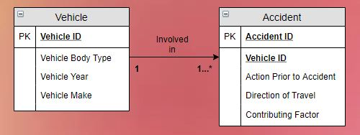
Conceptual Design
Main Entity:
Vehicle
Accident
Fig: ER Diagram

Slide 7
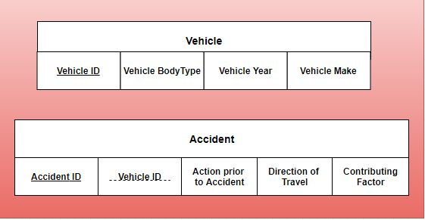
Logical Design
Primary Key:
Vehicle: VehicleID
Accident: AccidentID
Foreign Key:
Accident: VehicleID
Fig: Conversion of ER Diagram to two relational tables

Slide 8
Logical Design: Relations
Vehicle has Vehicle ID, Vehicle Body Type, Vehicle Year, Vehicle Make----->
Vehicle(Vehicle ID, Vehicle Body Type, Vehicle Year, Vehicle Make)
Accident has Vehicle ID, Action Prior to Accident, Direction of Travel, Contributing factor---->
Accident(Vehicle ID, Action Prior to Accident, Direction of Travel, Contributing factor)

Slide 9
Logical Design: Normalization
First Normal Form
Accident(AccID, Action Prior to Accident, Direction of Travel, Contributing Factor,VID,Vehicle Body Type,Vehicle Make,Vehicle Year)
Second Normal Form
Accident Table(AccID, VID, Action Prior to Accident, Direction of Travel, Contributing Factor)
Vehicle Table(VID, Vehicle Body Type, Vehicle Make, Vehicle Year)
Third Normal Form
Accident Table(AccID, VID, Action Prior to Accident, Direction of Travel, Contributing Factor)
Vehicle Table(VID, Vehicle Body Type, Vehicle Make, Vehicle Year)

Slide 10
Logical Design: 3NF
Database in 3NF
Accident Table(AccID, VID, Action Prior to Accident, Direction of Travel, Contributing Factor)
Vehicle Table(VID, Vehicle Body, Vehicle Make, Vehicle Year)

Slide 11
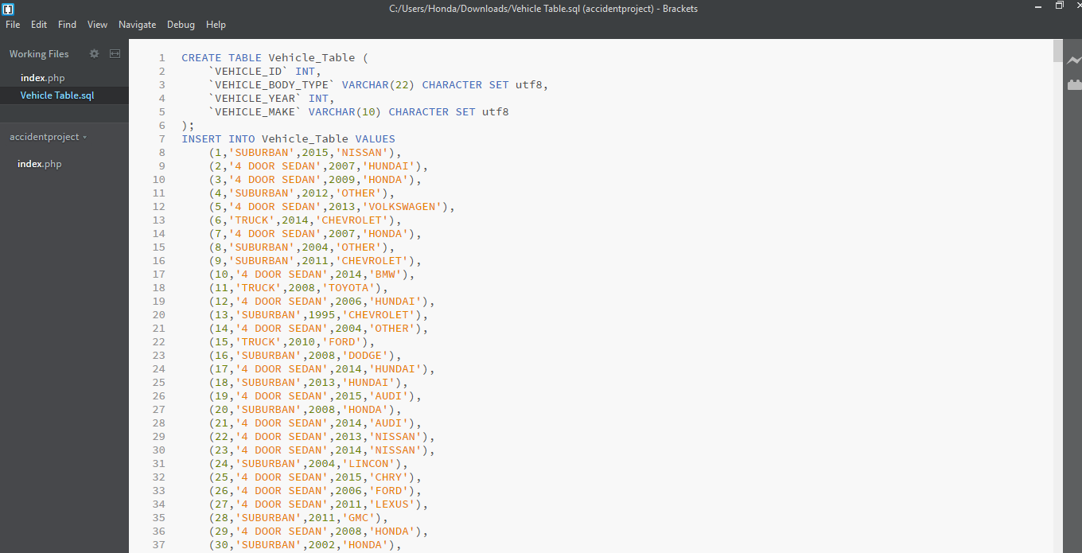
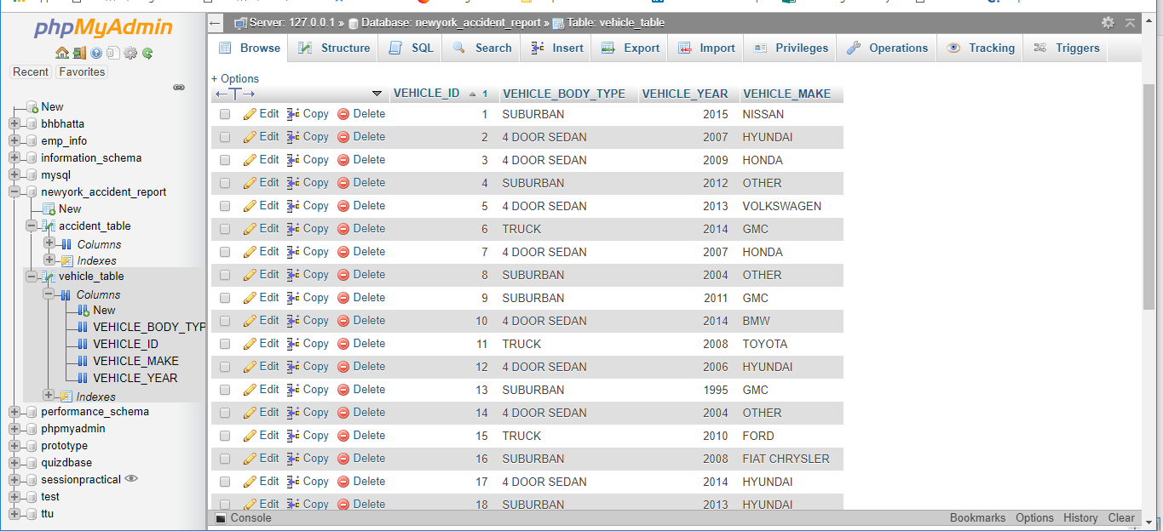
Physical Design: Create Tables
Result ---->

Slide 12
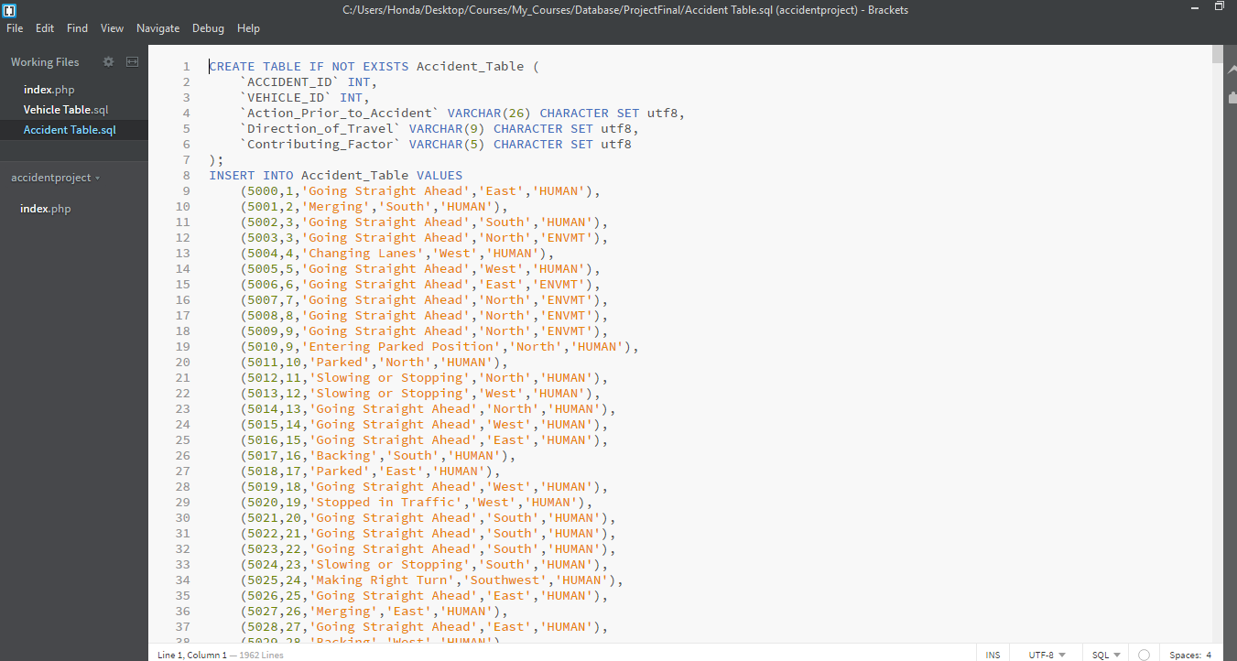
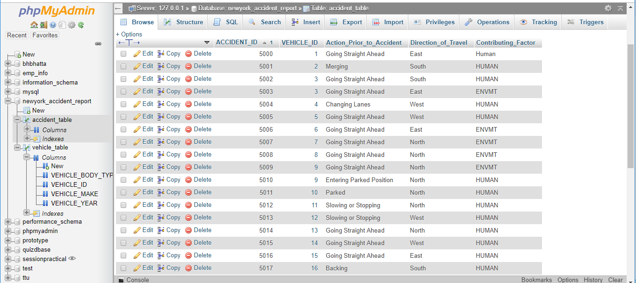
Physical Design: Create Tables
Result ---->

Slide 13
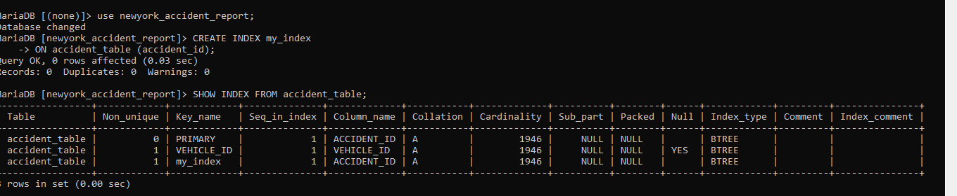
Physical Design: Define Index

Slide 14
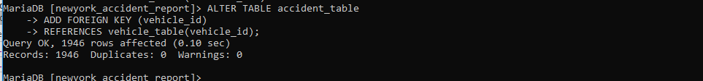
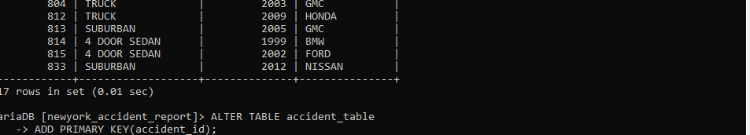
Constraints
We added a foreign key constraints on the
accident table which references the vehicle ID
attribute of the vehicle table.
We added a primary key constraint on the
accident table which references the accident ID
attribute of the accident table.

Slide 15
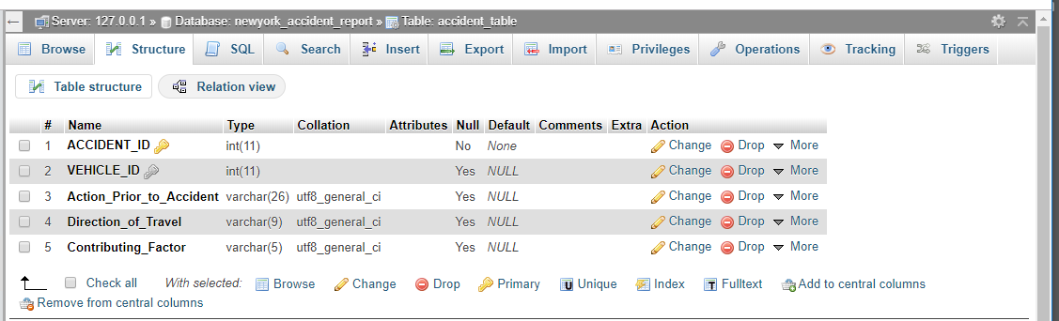
Constraints
Primary Key and Foreign Key on PhpMyAdmin Page

Slide 16
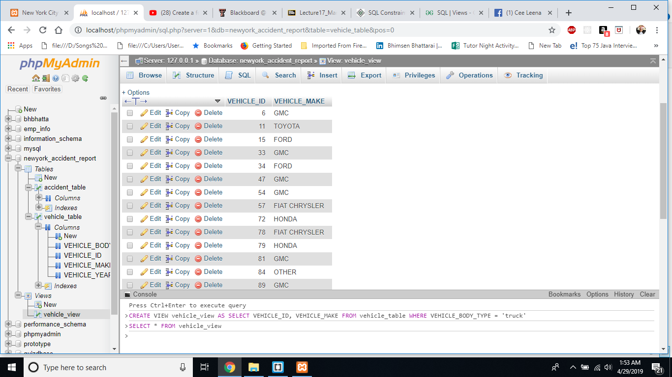
Physical Design: Create View(Vehicle_View)

Slide 17
Physical Design: Vehicle_View Results
Result ---->

Slide 18
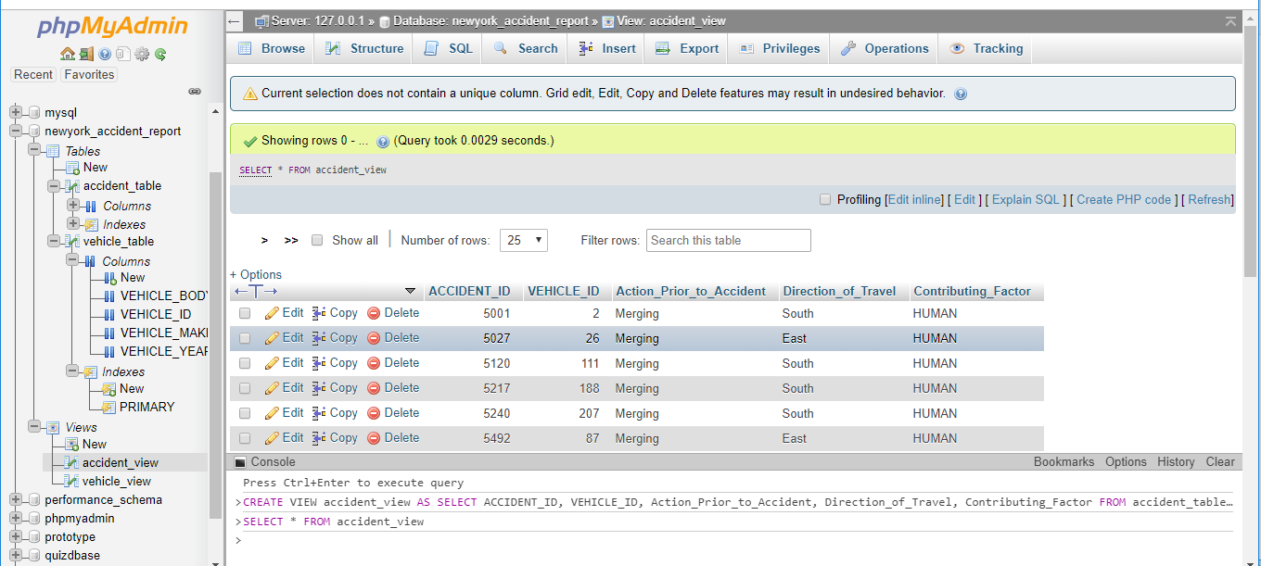
Physical Design: Create View (Accident_View)

Slide 19
Physical Design: Accident_View Results
Result ---->

Slide 20
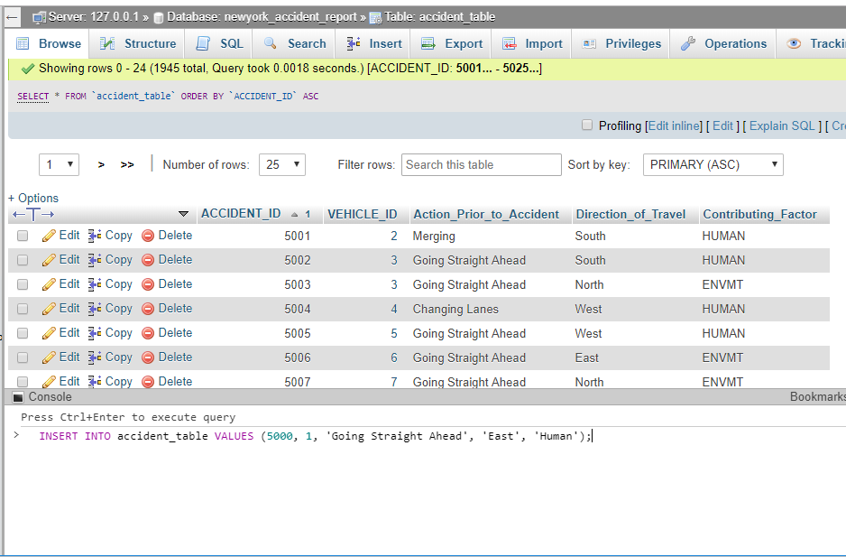
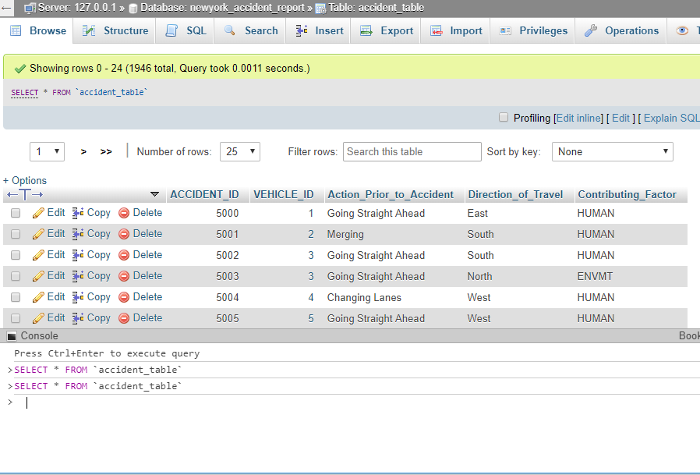
Validation
Three queries used for Validation of the dataset:
Insert: Inserted new row on accident table with:
accident_id:5000, vehicle_id:1, action_prior_to_accident: ‘Going Straight Ahead’, direction_of_travel: ‘East’, contrib uting_factor: ‘Human’

Slide 21
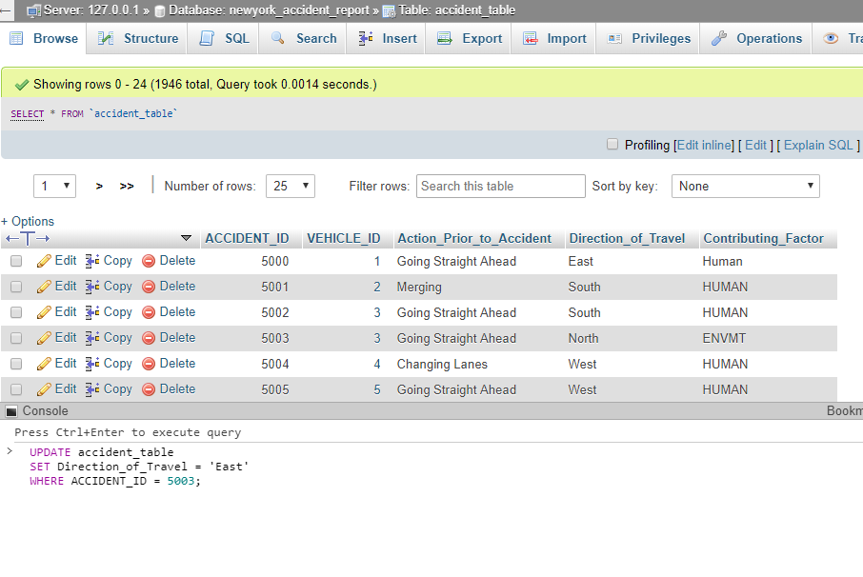
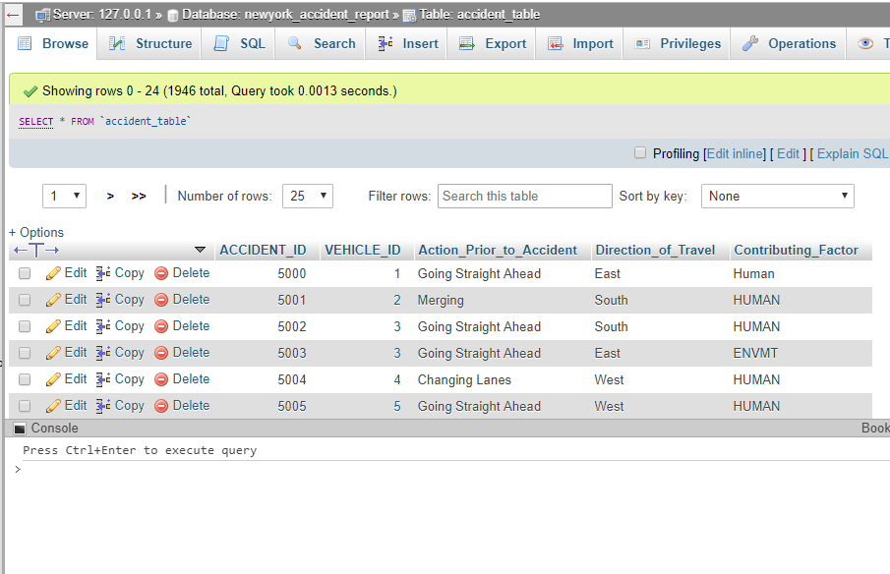
Validation
2. Update: Updated accident table with:
direction_of_travel from north to east for row with accident_id: 5003

Slide 22
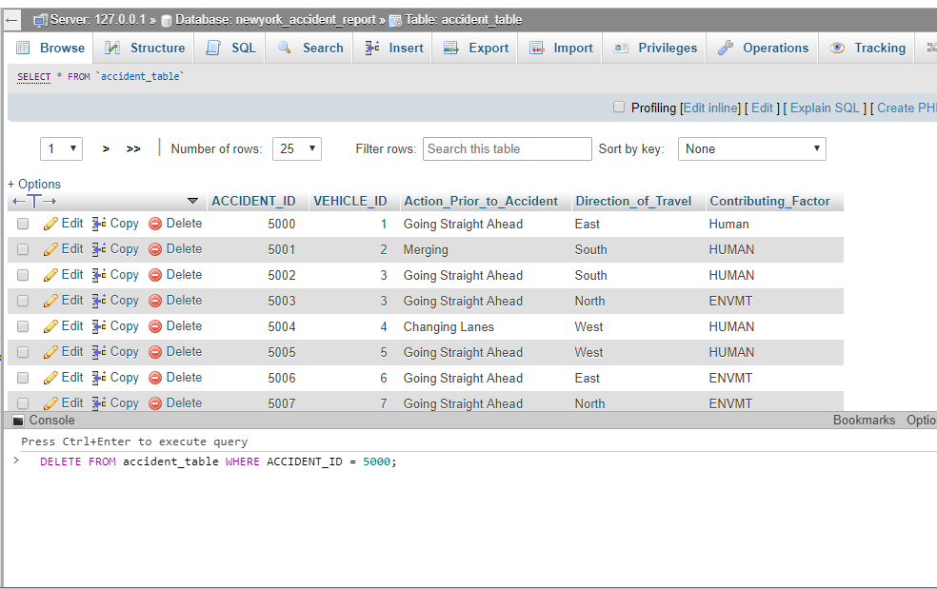
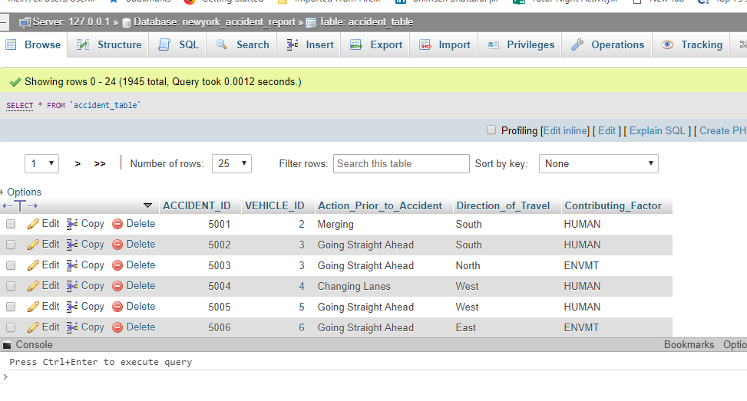
Validation
3. Delete: Deleted from accident table row with accident_id: 5000

Slide 23
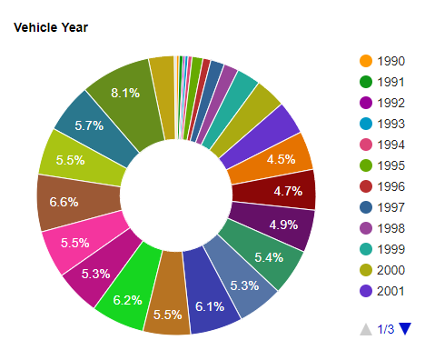
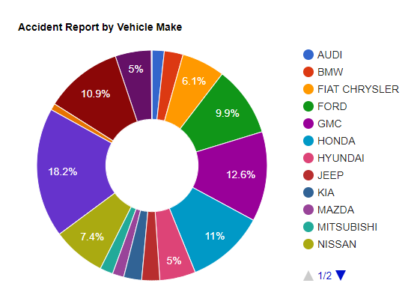
Contribution/Findings
Fig: Illustration Report by Vehicle Year
Fig: Illustration Report by Vehicle Make

Slide 24
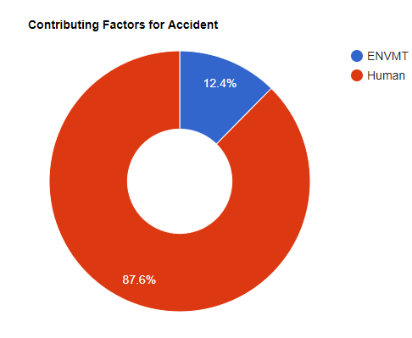
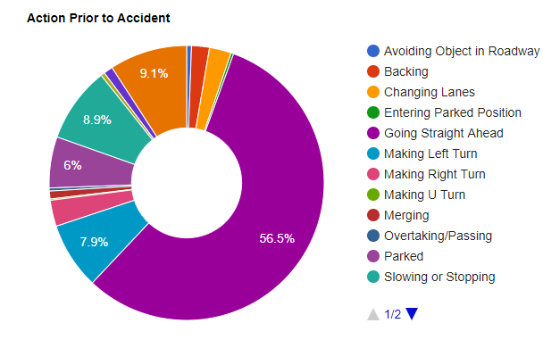
Contribution/Findings contd.
Fig: Illustration Report by Contributing factor
Fig: Illustration Report by Action prior to Accident

Slide 25
Video Demo
Click for Final Demo

Slide 26
Thank you
End of Semester

